Slide 1
A feature selection approach to increasing classification performance

Slide 2
INTRODUCTION :
System focuses on classification task of data mining and high dimenstional issue of preprocessing .
Data set with more no. of features called “HIGH DIMENSIONAL DATA SET”.
It may create different problems to learning the module.
Few features may repeated and noisy , It create confusion and reduce efficiency of module .This issue can resolved by features selection technique by using CCE(correlation coefficient) & SU(symmetrical uncertainity)
Notes:
g

Slide 3
Scope:
To system focuses on data mining here by using correlation coefficient and symmetrical uncertainty.
It contains procedure to constructor the cluster of features and suggesting best feature from each cluster.
IG is employed over dataset thereafter wrapper method applied to find better classification performance.
System removes redundant and independent attributes with class level.
CCE is considerd for relationship between two variables.
SU is considerd to fix minimum value of weight

Slide 4
Objective :
Extracting the better features.
To increase the classification performance.
Reduce high dimensionality.
To tackle high dimensionlity hence using correlation coefficient and symmetrical uncertainity.
To propose an unsupervised feature selection methodology to address the high dimensionality issue using clustering and filter based methods.
To evaluate proposed methods and compare with the existing methods using various classifiers.

Slide 5
System Architecture
Input data set
Apply SU
Calculate CCE between every feature
Convert binary weighted matrix
Compare with existing
Group the similar weighted features in one cluster
Choose the strong feature in each cluster
Subset of features

Slide 6
System Working
CSV File as input
X | y
43 | 99
 | 10 | 20
21 | 65
25 | 79
10 | 12 | 58
42 | 75
57 | 87
59 | 81
10

Slide 7
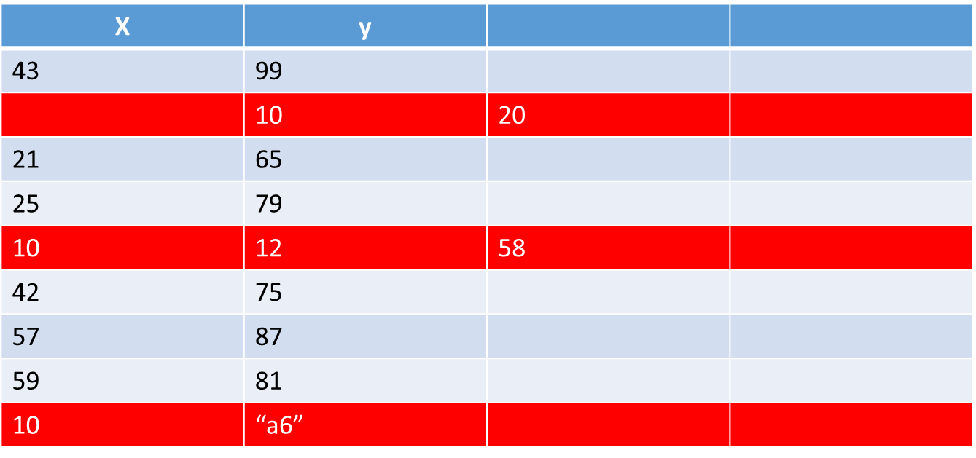
Data Preprocessing
Noisy and Missing values Mislabeled Imbalanced
3 rows are drop due to invalid data
6 rows are selected for next processing

Slide 8
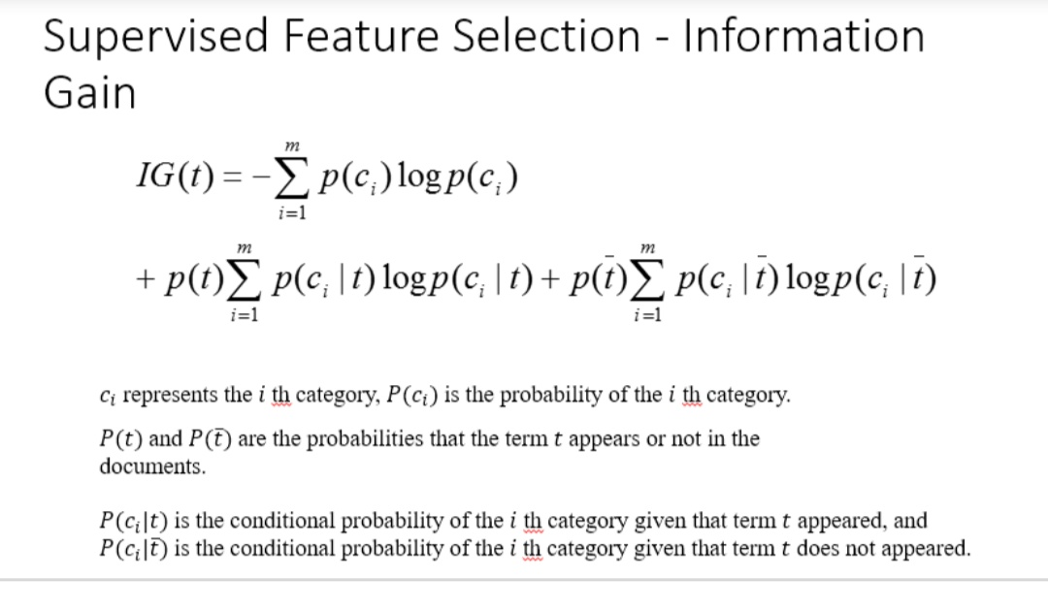
Find SU for each feature and sort decending order by SU
SU | Feature No | Feature Name
.19 | 10 | j
.19 | 8 | h
.19 | 7 | g
.18 | 9 | i
.15 | 2 | b
.09 | 1 | a
.07 | 4 | d
.06 | 3 | c
.06 | 5 | e
.02 | 6 | f
SU=(2*IG)/(H(X)+X(Y))
H(X)=-∫p(x)log(p(x))შx

Slide 9
Choose the middle feature’s SU value as t
SU | Feature No | Feature Name
.19 | 10 | j
.19 | 8 | h
.19 | 7 | g
.18 | 9 | i
.15 | 2 | b
.09 | 1 | a
.07 | 4 | d
.06 | 3 | c
.06 | 5 | e
.02 | 6 | f
T=.15

Slide 10
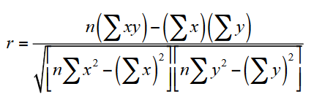
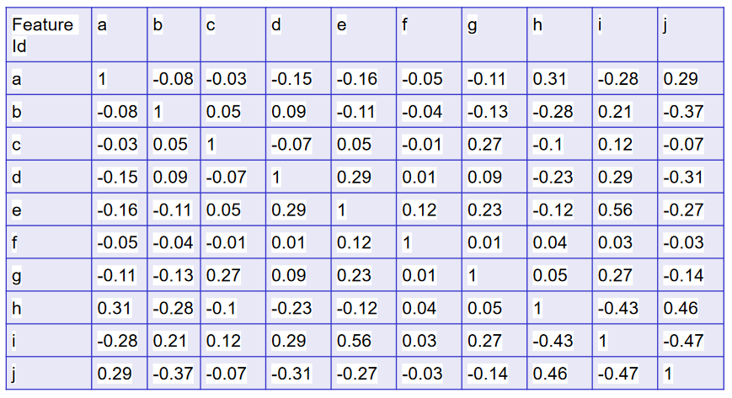
Generate the Correlation coefficient symmetrical matrix

Slide 11
Proposed methodology:
.Find out the Symmetric Uncertainty (SU) value of each feature, such that all features will be in descending order of its SU value.
2.Choose the middle feature SU value as Threshold (T).
3.Generate the Correlation Coefficient Symmetrical matrix (CCE(Xi,Yi)) of initial data set .
4.Transform the above matrix to weighted binary matrix (WB) as per the below steps:
for(i=1 to n)
for(j=1 to n)
if(CCE(Xi,Yi)>T)WB(Xi,Yi)=1
elseWB(Xi,Yi)=0
End
End

Slide 12
5. Calculate the total weight of each feature W(F) as per below steps.:
for(i=1 to n)
for(j=1 to n)
W(Fi)= WB(Xi,Yi)
End
End`
6. Group the features which are having same weight(W(F))Clusteri={Fi1, Fi2,...Fik} /* i is the cluster id, increment i by 1 until all features are formed */7. Choose the best feature (feature which has maximum SU value) from each cluster and form the final candidate subset for(i=1 to last cluster)Fi= MAX SU(clusteri)Candidate Feature set (CFS)<-FiEnd

Slide 13
references
Correlation Coefficient Based Candidate Feature Selection Framework Using Graph Construction
SP Potharaju, M Sreedevi
Gazi University Journal of Science 31 (3), 775-787

